Slide 1
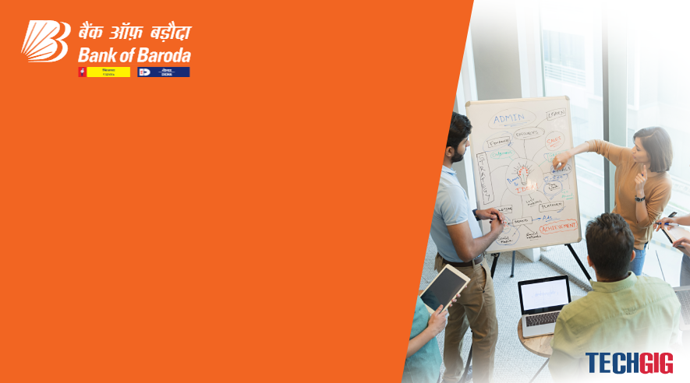

Bank of Baroda Hackathon - 2022
Technology Partner
Your Team Name :Team Rainbow
Your team bio : Abhisek padhi (Team Leader)
+91 9439831236
Bhabani Choudhury (Team Member)
+91 9178963236
Date : 20.09.2022

Slide 2
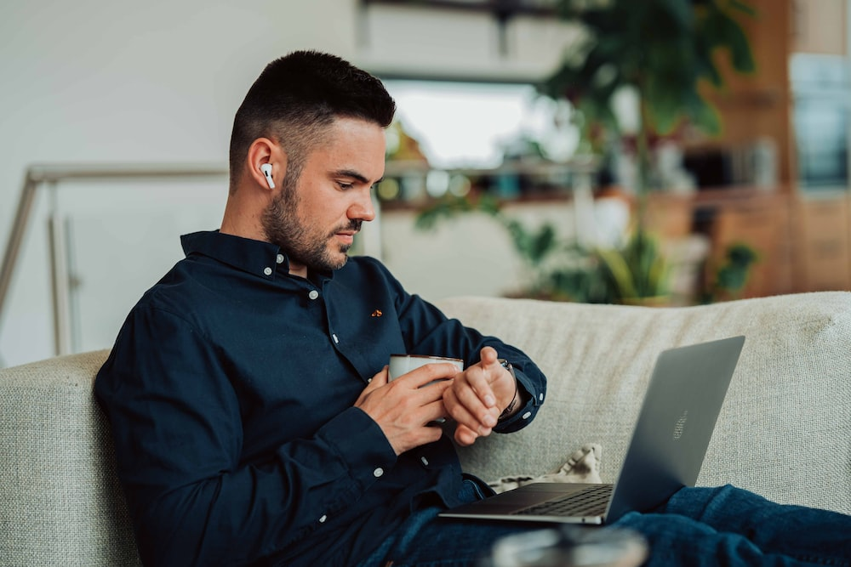
Problem Statement?
Why did you decide to solve this Problem statement?
37 crore Gen Z population is going to become adult in next 10 years, who were born with earpods, alexa etc.
This population was born with hyper connectedness and efficient processes of app economy.
2.1 crore Gen-Z is already using 35+ social networking, audio content apps, traditional banks must leverage.

Slide 3
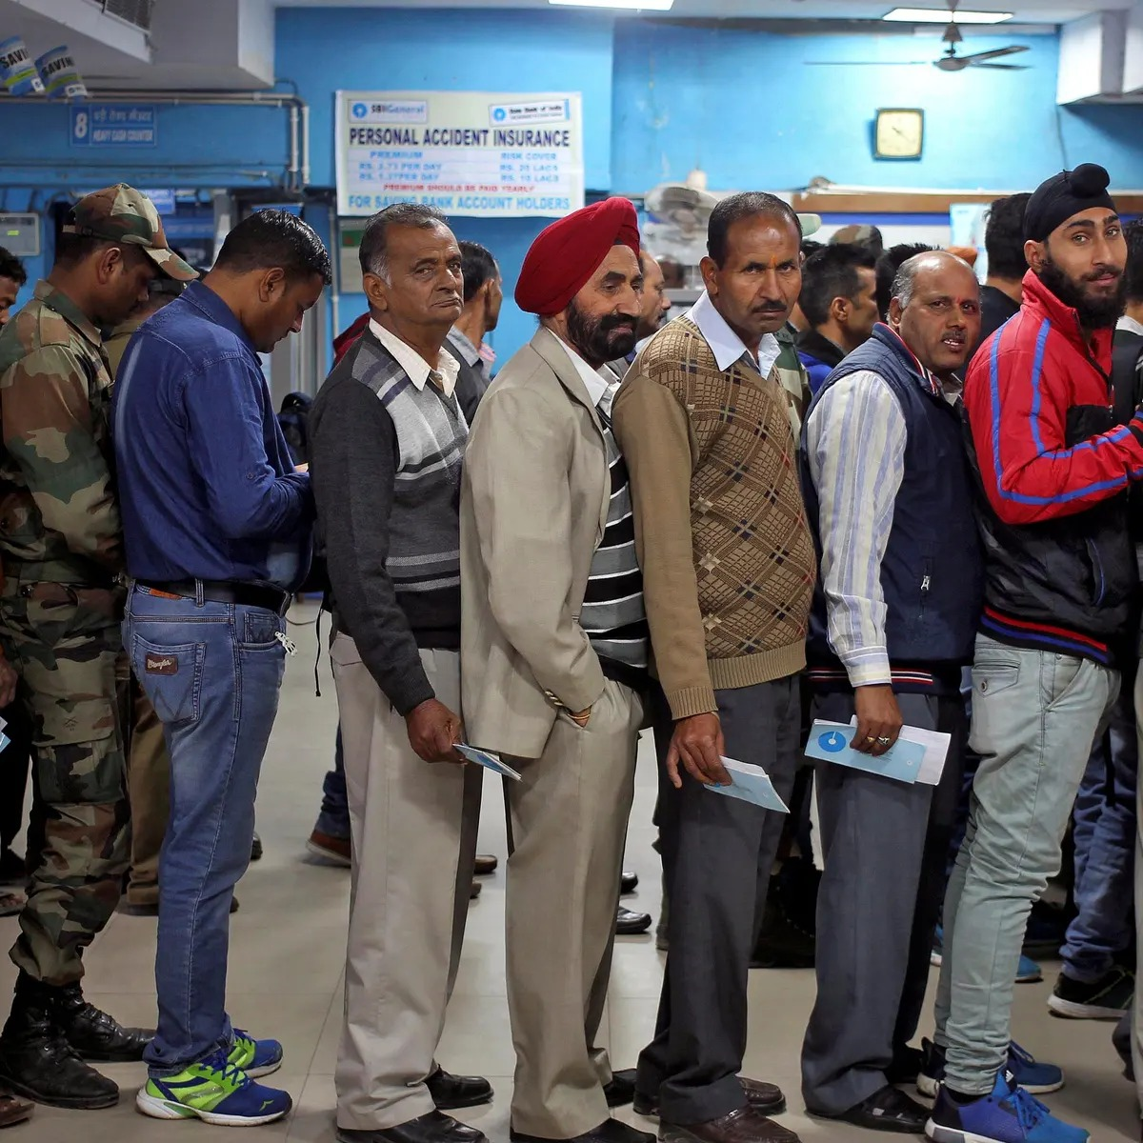
User Segment & Pain Points
Which user /advertiser segment would be early adopter of your product & why?
- 37 crore Generation-Z
- Habituated with app ecosystem and spend 30% of their awake time with earpods either talking or listening
- 8-12 seconds attention span, look for faster processes everywhere

Slide 4
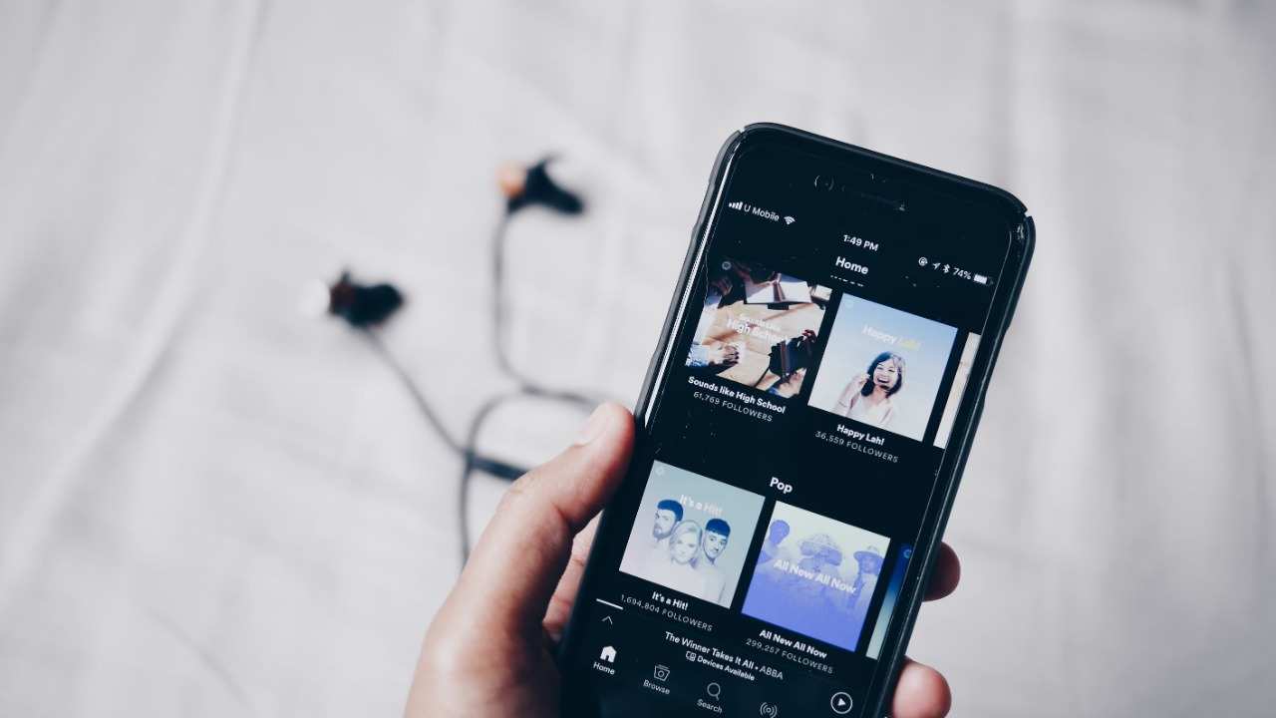
Pre-Requisite
What are the alternatives/competitive products for the problem you are solving?
- 2.1 crore Gen-Z is already using 35+ social audio apps, traditional banks must innovate
- Ex: Clubhouse, Kuku FM etc.

Slide 5

Azure tools or resources
Azure tools or resources which are likely to be used by you for the prototype, if your idea gets selected - Azure VM - compute resource - Azure Database for MySQL - Azure Cache for Redis - Azure speech service

Slide 6
Any Supporting Functional Documents
Present your solution, talk about methodology, architecture & scalability
We are building a dynamic speech recognition & verification system that generates unique speech fingerprints based on the combination of speech inputs provided during onboarding.
We are assigning the attributes like shrillness, loudness, tonality, phonetics, & few other attributes to generate a unique speech profile for each customer.
Azure cloud helps us to run this model scalable.

Slide 7
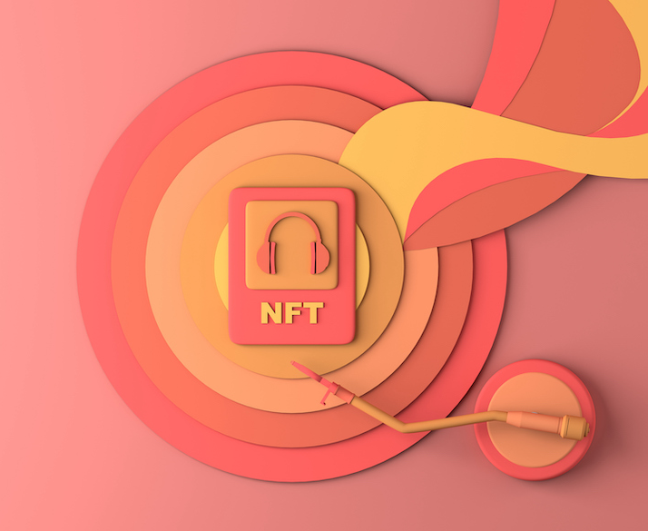
Key Differentiators & Adoption Plan
How is your solution better than alternatives and how do you plan to build adoption?
Differentiation: Metaverse ready, unique shareable digital identity
- Gift a NFT of the generated audio visualization on account opening

Slide 8
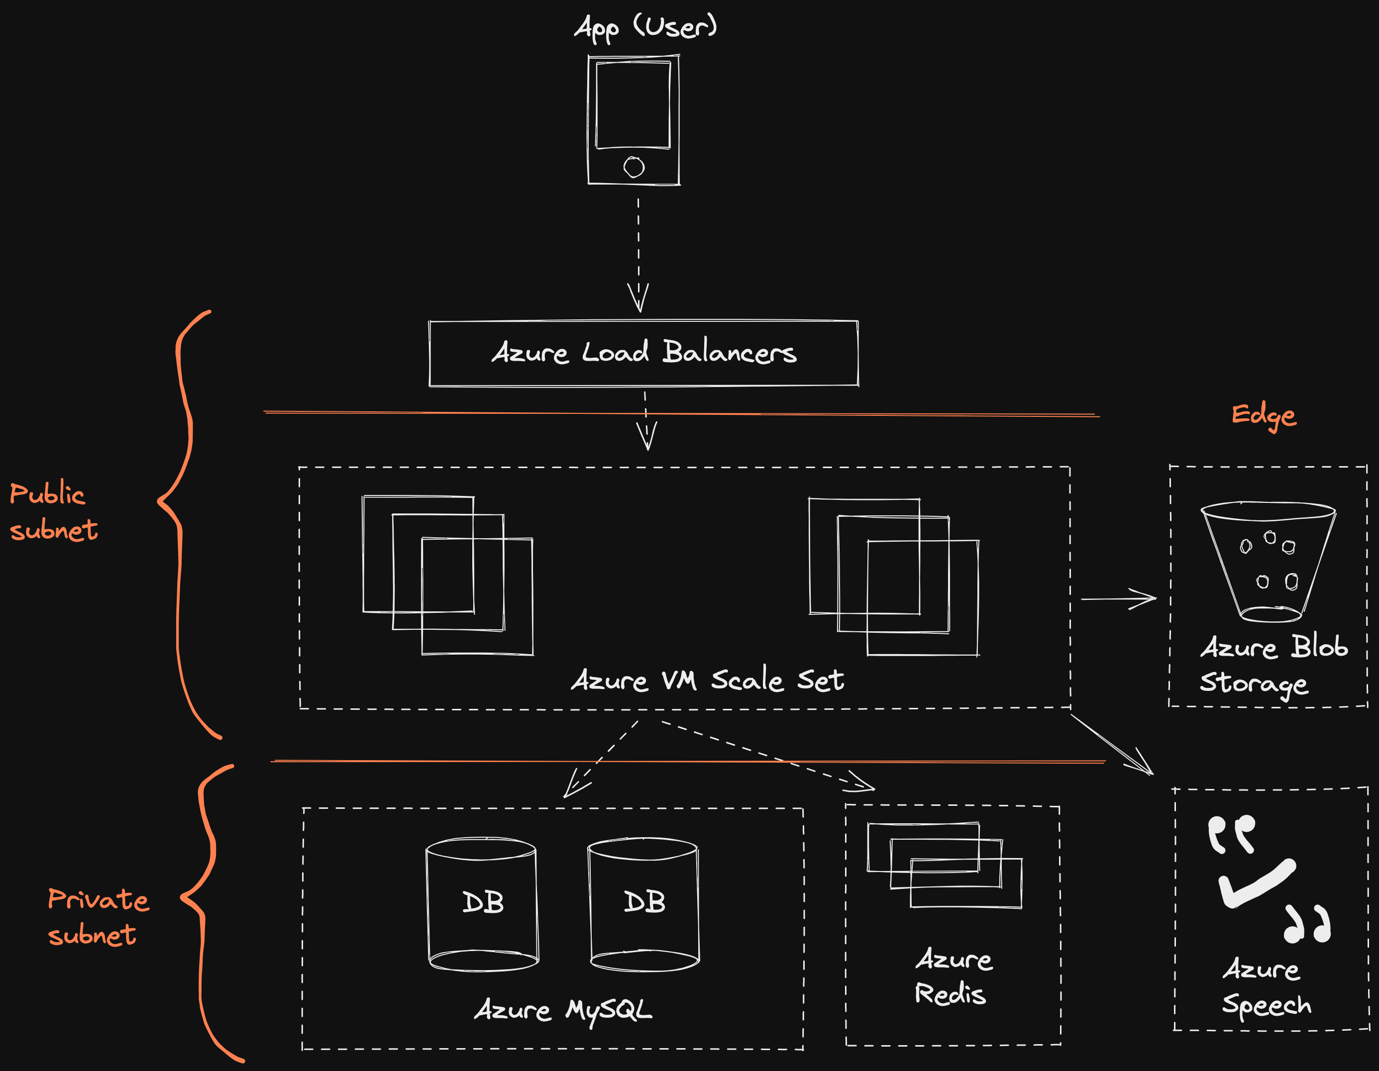
GitHub Repository Link & supporting diagrams, screenshots, if any
How far it can go?
It can work at population scale
GitHub Repository Link
https://github.com/abhisekpadhi/bob-alt-auth

Slide 9
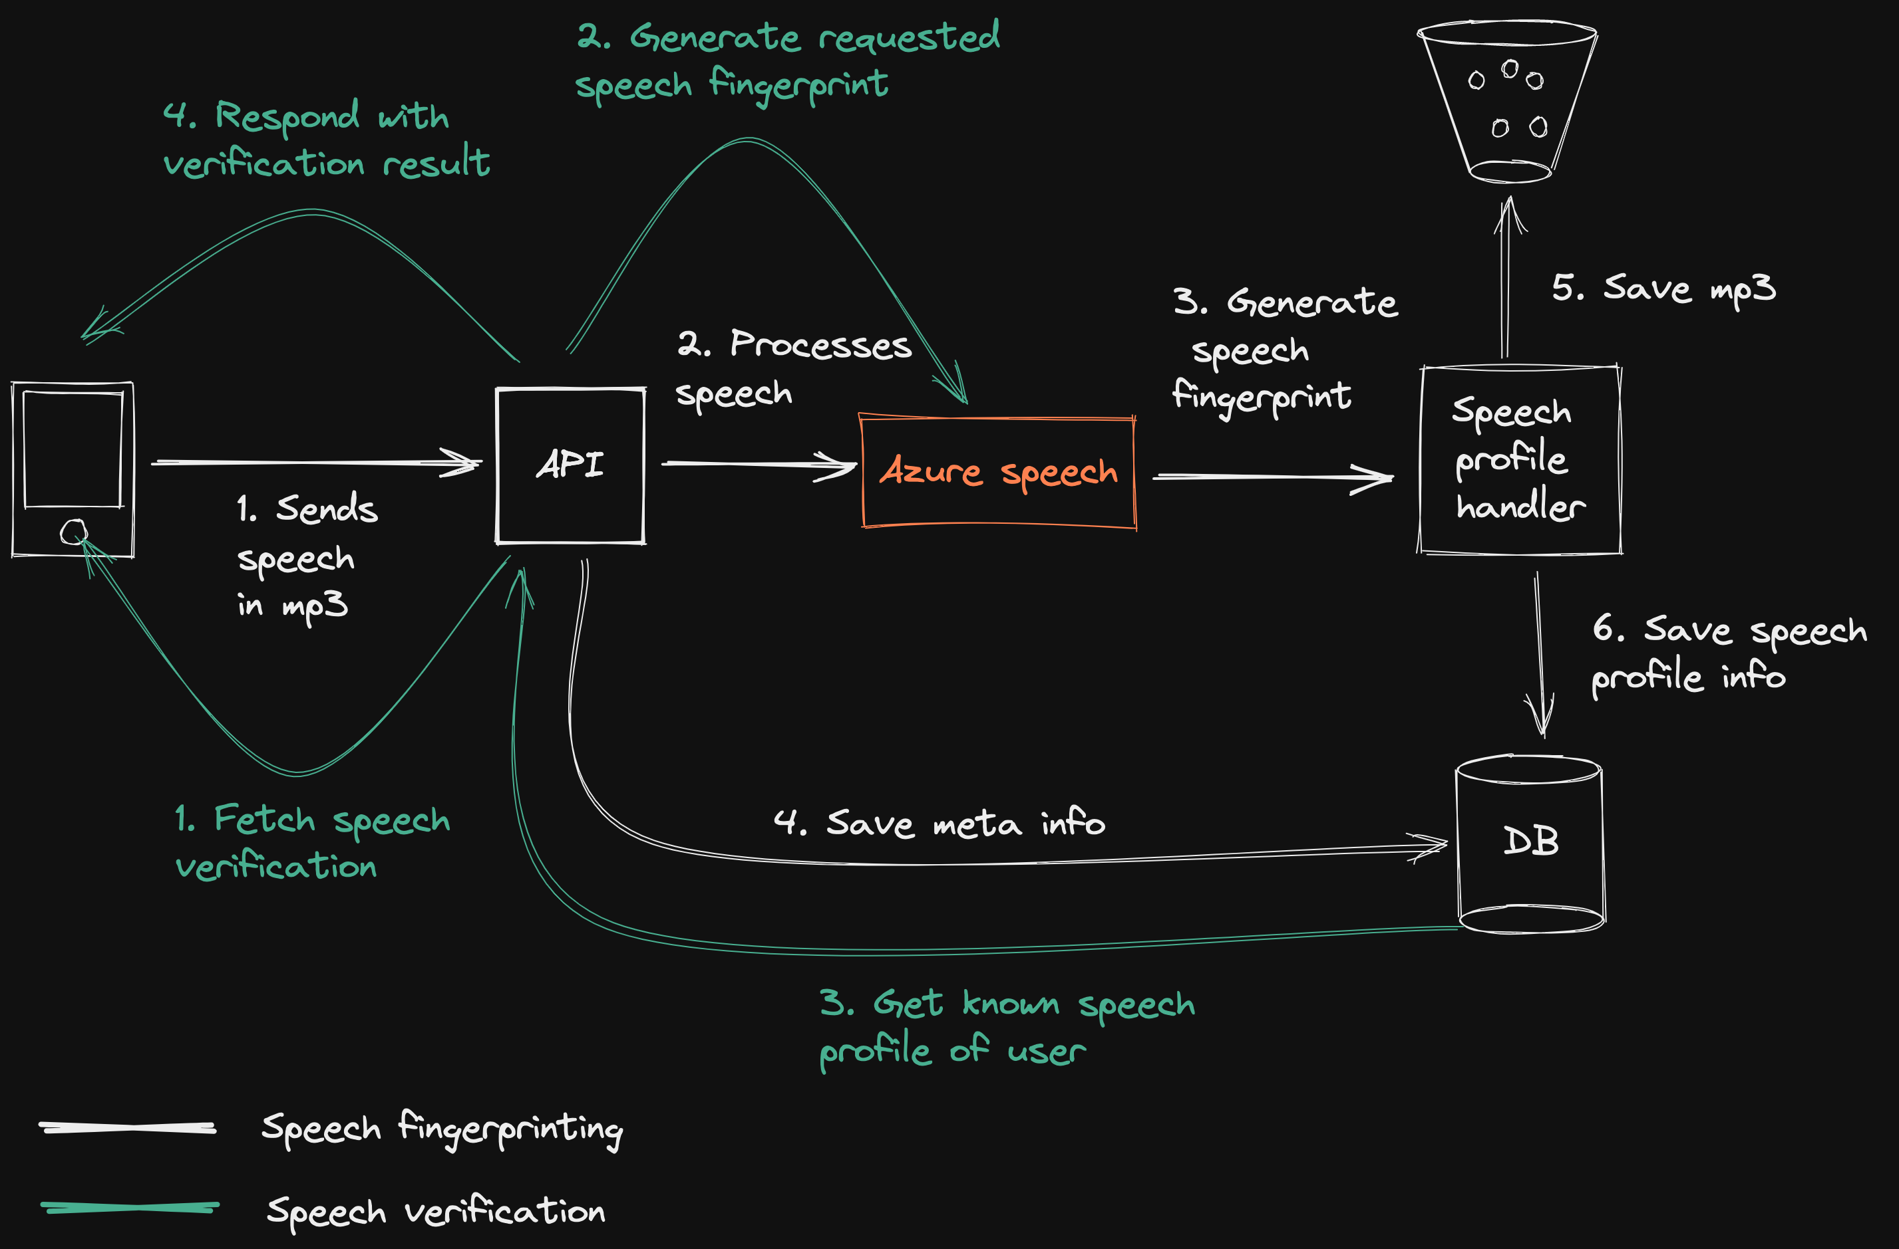

Slide 10
Thank You
Team member names
Abhisek padhi (Team Leader)
+91 9439831236
Bhabani Choudhury (Team Member)
+91 9178963236

